Slide 1
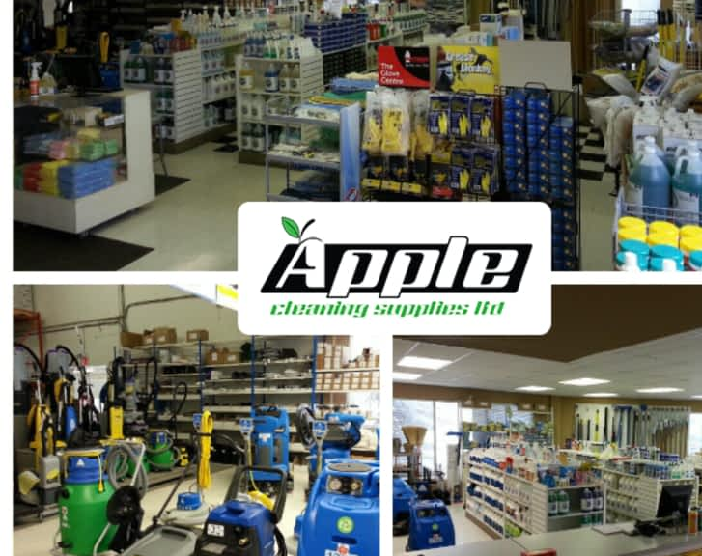
Eco Cleaning Supply Cloud Architecture
Group 7 : Vakul, Chander Shekhar, Naeem

Slide 2

Outline:
Introduction
Objectives
Mission
Purpose
Source
Data Sinks
All 3 Phases
Key Benefits
Conclusion

Slide 3

Introduction:
Our cloud architecture for Eco Cleaning Supply simplifies how data is collected, managed, and used. By combining different data sources into a single system, it provides real-time insights to improve decision-making and efficiency. Designed for growth and cost savings, it helps the business deliver better customer experiences, optimize operations, and stay ahead in a competitive market.

Slide 4
Objectives:
Unify Data for Better Understanding: Bring together customer feedback, sales, and delivery data into one central place to see the full picture of our business.
Enable Smarter Decisions: Use real-time analytics and dashboards to empower teams to make quicker and more informed choices.
Streamline Operations: Simplify processes like inventory tracking, delivery planning, and financial reporting to save time and reduce errors.
Personalize Customer Experiences: Use data to better understand customer needs, improve services, and make interactions more meaningful.

Slide 5

Mission:
Empowering Eco Cleaning Supply to unlock the full potential of its data by creating a smart, cloud-based ecosystem. Our mission is to simplify how data is collected, organized, and analyzed, so the company can make faster, smarter decisions. By using cutting-edge tools like Azure Synapse Analytics and Power BI, we aim to help Eco Cleaning Supply deliver better services to customers, streamline operations, and stay ahead in the competitive market.

Slide 6
Purpose:
The purpose of this cloud architecture is to empower Eco Cleaning Supply with the ability to harness the full potential of their data. By integrating data from diverse sources like customer feedback, retail sales, and supplier information, this solution aims to:
Simplify decision-making with clear and actionable insights.
Boost operational efficiency by automating repetitive tasks and streamlining workflows.
Enhance customer satisfaction by tailoring services to meet their needs and expectations.

Slide 7
Sources:
Source | Definition | Data Type
Retail Stores (Requests) | Data from point-of-sale systems, including requests for cleaning supplies and inventory updates. | Structured (e.g., sales records, inventory requests)
E-commerce (Requests) | Orders and requests made through the online store. | Structured (e.g., transaction logs, customer profiles)
Customer Feedback | Customer Experience and complaint data captured through forms or tickets. | structured (e.g., forms stored as JSON/XML)
Suppliers (Information) | Supplier data, including raw material availability, delivery schedules, and pricing. | Structured (e.g., tabular supplier data in databases)
Currency Data | Exchange rate data fetched from APIs for multi-currency support. | Structured (e.g., real-time API responses in JSON/XML)
Social Media Data | Insights are used to optimize advertising strategies, predict social media trends, and measure brand engagement | structured (e.g., free-text customer reviews)

Slide 8
Data Sinks (Where the Processed Data Goes)​
Sink | Definition | Data Type
Inventory System | Processed data about stock levels, inventory allocation, and reordering. | Structured (e.g., tabular format in relational databases)
Delivery Management System | Data for optimizing delivery routes, tracking deliveries, and driver assignments. | Structured (e.g., logistics tables, real-time GPS feeds)
Customer Experience Dashboards | Aggregated and visualized data for monitoring customer sentiment and satisfaction trends. | structured (e.g., visual analytics tools like Power BI)
Marketing Insights | marketing campaigns, analyzing trends, gaining performance insights, and leveraging social media data to understand audience behavior and drive targeted strategies. | structured (e.g., JSON-based marketing reports)
Accounting System | Consolidated financial data for budgeting, expense tracking, and profit analysis. | Structured (e.g., ERP or financial systems)
Operational Dashboard | Data insights to identify inefficiencies, reduce operational costs, and forecast savings. | structured (e.g., reports in Excel or BI dashboards)

Slide 9
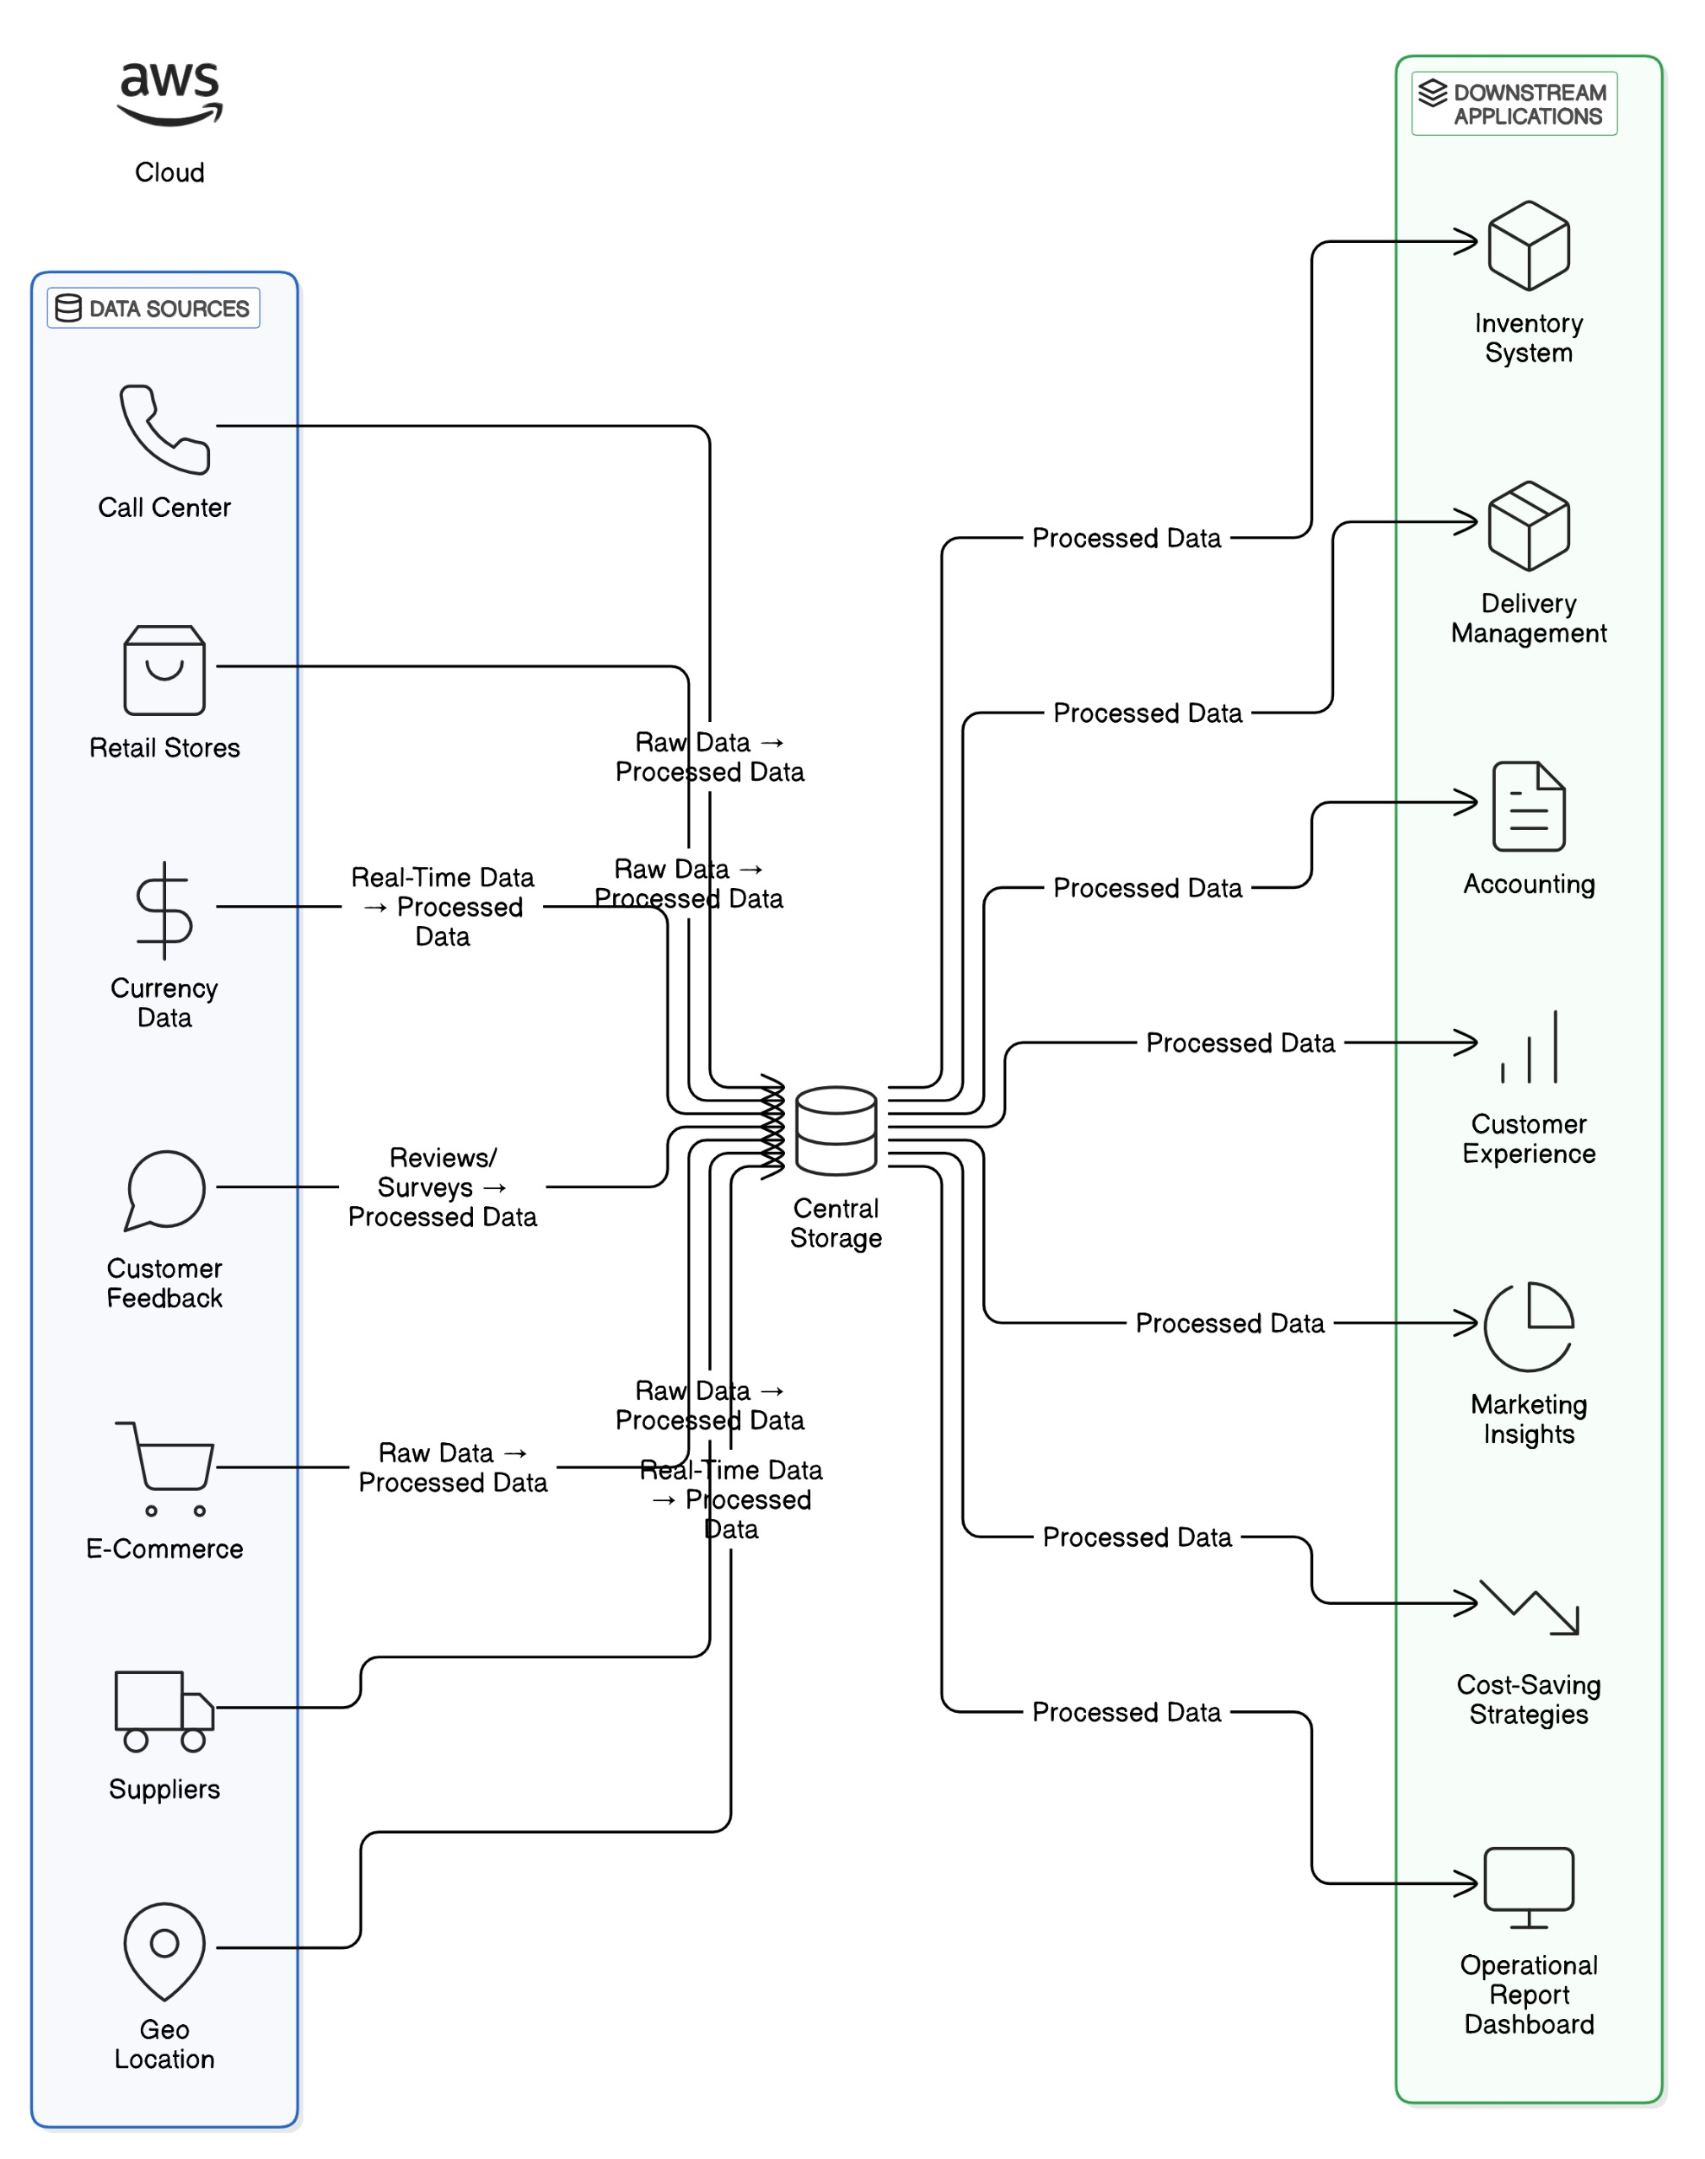
Phase 1:

Slide 10
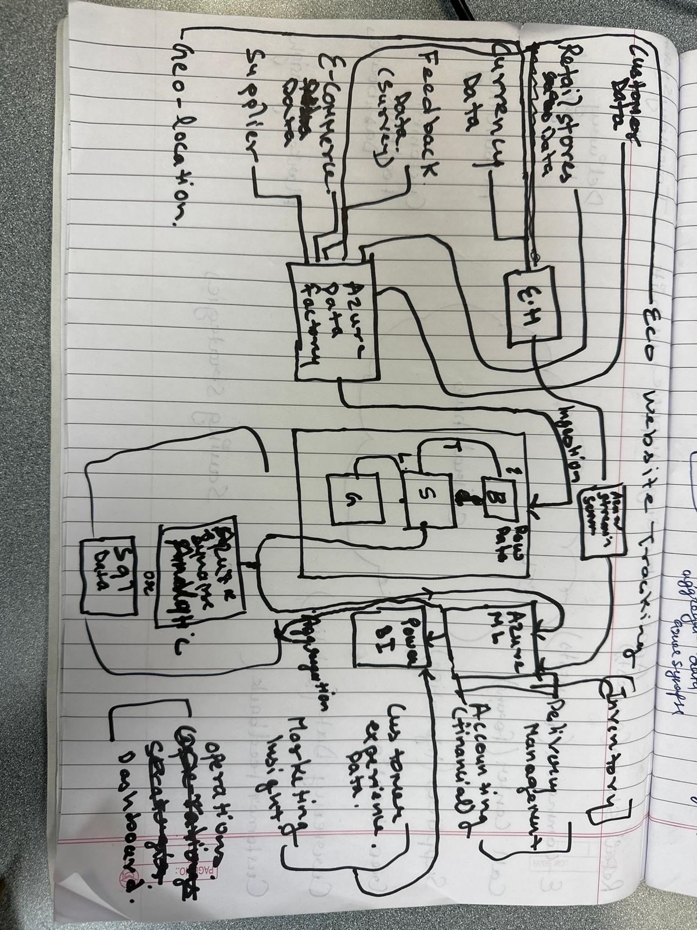
Phase 2:

Slide 11
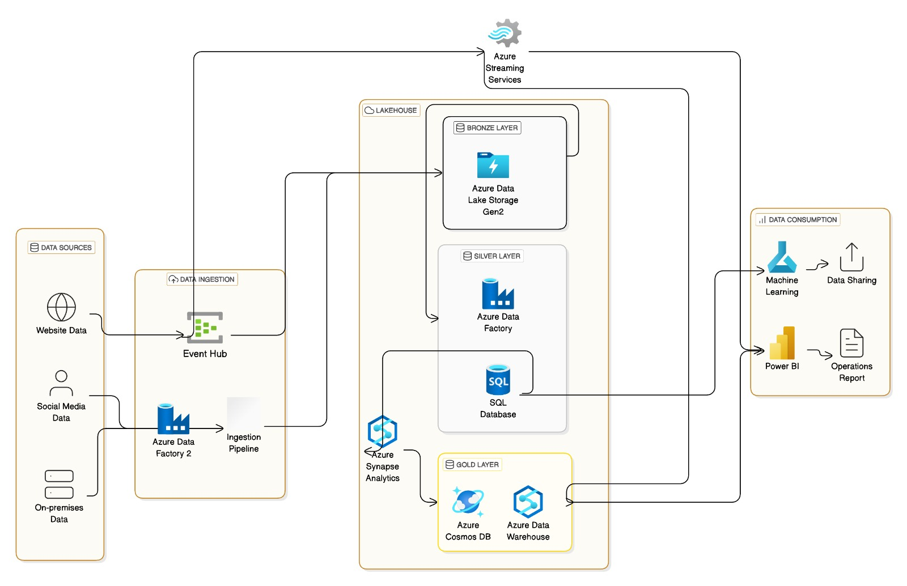
Phase 3:

Slide 12
Key Benefits:
Data Centralization: All data sources, including social media, are integrated into a unified Lakehouse architecture.
Handles Social Media Data: Social media data is ingested and processed to identify trends, analyze customer demand, and enhance advertisement strategies.
Real-time Insights: Faster and more informed decision-making through live dashboards and streaming analytics.
Scalability: The architecture is designed to scale effortlessly as the business grows, ensuring continuous performance.
Cost Efficiency: Optimized storage and processing are achieved by separating compute and storage layers.
Enhanced Analytics: Support for advanced machine learning and predictive modeling, enabling better forecasting and segmentation.
Improved Customer Experience: Leveraging insights for personalized services and proactive customer support.

Slide 13
Conclusion:
The proposed cloud architecture for Eco Cleaning Supply ensures:
Seamless Integration: The architecture brings together data from various sources effortlessly.
Efficient Processing: It ensures quick and streamlined data handling.
Real-Time Insights: Enables real-time analytics for faster decision-making.
Actionable Outcomes: Provides insights that drive impactful strategies.
Operational Excellence: Supports smoother and more efficient business operations.
Customer Satisfaction: Helps enhance customer experiences through data-driven approaches.
Business Growth: Acts as a solid foundation for innovation and long-term success

